Slide 1
Class Notes (5/2/2016)
Today
Air Pollution (Chp 14)
Climate Classifications(Chp 13)
Climate Change (Chp 13)
Monday May 9
Virtual Class – “Skeptical Science” HW13

Slide 2
Class Notes (5/2/2016) cont’d
Monday May 16
REVIEW for Final
TERM PAPERS DUE
Monday May 23 – 6:30 PM
FINAL EXAM
Extra Credit Term Papers Due

Slide 4
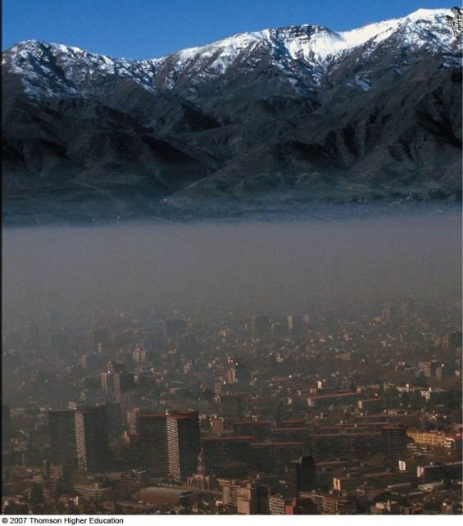
Air Pollution

Slide 5
Principal Air Pollutants
Primary and Secondary pollutants
Particulate matter
PM10, PM2.5 (10 microns and 2.5 microns)
Carbon monoxide
Sulfur dioxide
Volatile Organic Compounds
Nitrogen oxides

Slide 6
Natural Air Pollutants
Source | Pollutant
Volcanic Eruptions | Particulates(dust,ash) Gases (SO2, CO2)
Forest Fires | Smoke, hydrocarbons, CO2, ash
Dust Storms | Suspended particulate matter
Ocean Waves | Salt particles
Vegetation | Hydrocarbons
Hot Springs | Sulfurous gases

Slide 7
Human Air Pollutants
Source | Pollutant
Paper Mills | Particulate, sulfur oxides
Coal Power Plants | Ash, sulfur oxides, nitrous oxides
Oil Power Plants | Sulfur oxides, nitrous oxides, CO2
Refineries | Hydrocarbons, sulfur oxides, CO2
Manufacturing | So2, H2SO4, particulates, various other oxides, nitrous oxides, smoke fumes dust
Automobiles | CO, nitrous oxides, hydrocarbons, VOC (volitile organic compounds), particulates
Furnaces, fireplaces | CO, particulates
Waste Burning | CO, particulates

Slide 8
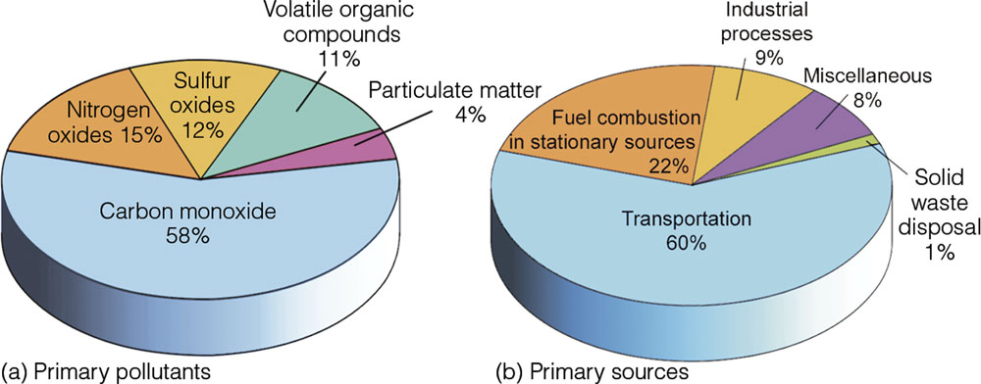
Principal Air Pollutants
Globally, a large percentage of air pollution sources are natural, but locally human-caused sources are often the largest contributors.

Slide 9
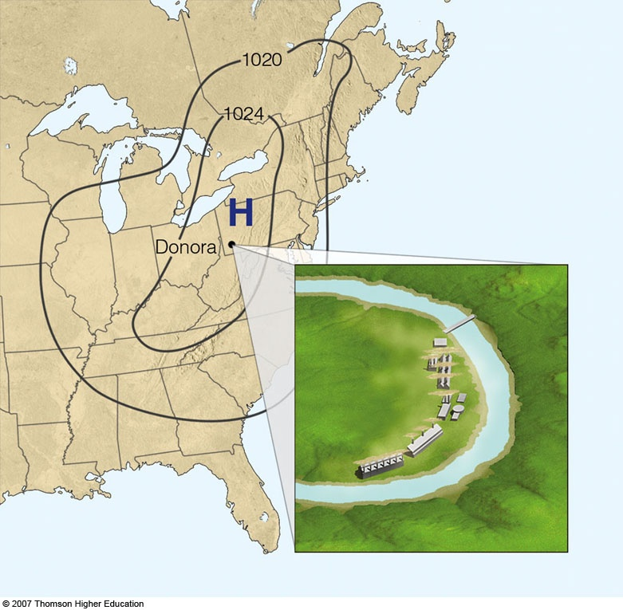
SMOG
Combo of words SMoke and fOG (1905)
Photochemical Smog (1950s)
Sunlight + Heat + VOCs and NOx → Ozone and PM
Great London Smog of 1952
12K died
Andora, PA (1952)
5 days of Stagnant High
Trapped Pollutants from Coal and Steel mills
22 died

Slide 10
Air Pollution Standards
Primary air quality standards
Ozone (O3)
Particulate Matter (PM)
Carbon Monoxide (CO)
Nitrogen Dioxide (NO2)
Sulfur Dioxide (SO2)
Lead (PB)
Secondary air quality standards
Air Quality Index (AQI)

Slide 11
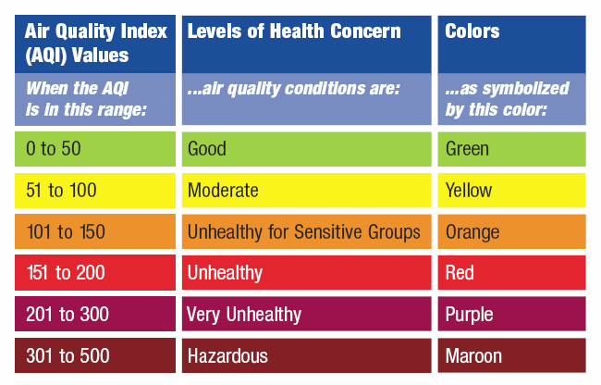
Air Quality Index (AQI)
Different triggering values for each pollutant

Slide 12
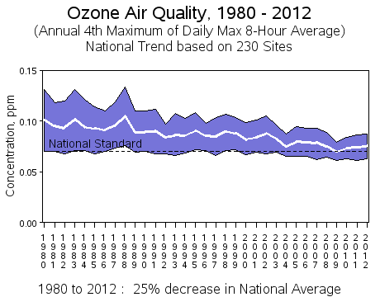
Air Pollution Trends

Slide 13
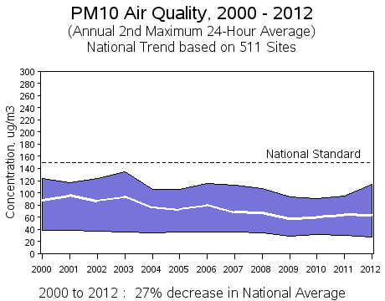
Air Pollution Trends

Slide 14
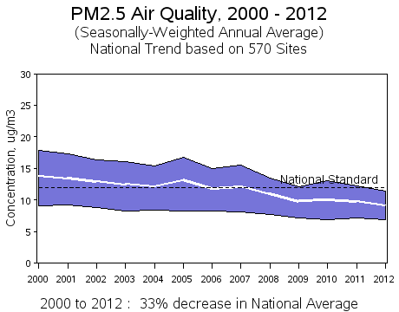
Air Pollution Trends

Slide 15
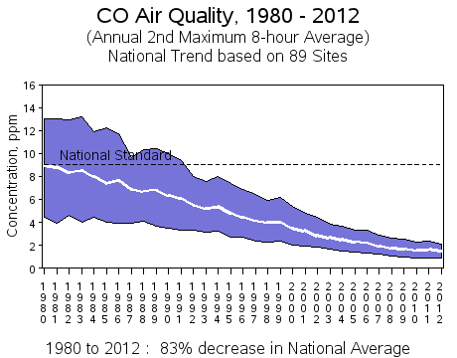
Air Pollution Trends

Slide 16
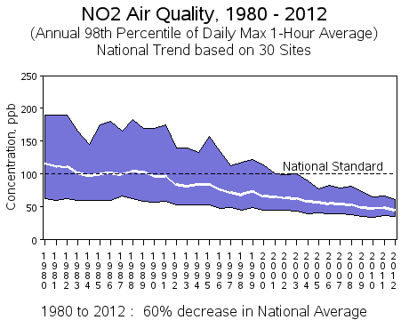
Air Pollution Trends

Slide 17
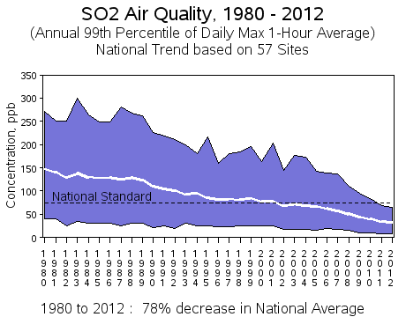
Air Pollution Trends

Slide 18
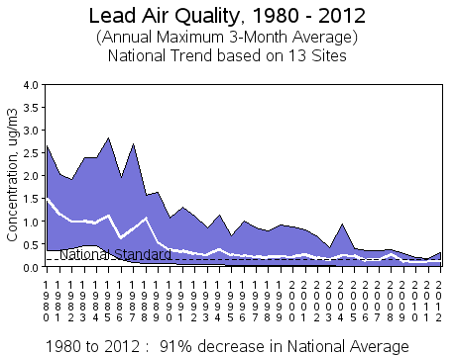
Air Pollution Trends

Slide 19
Air Pollution Trends
In Summary, all categories of Air Quality Trends have been improving since 1980.

Slide 20
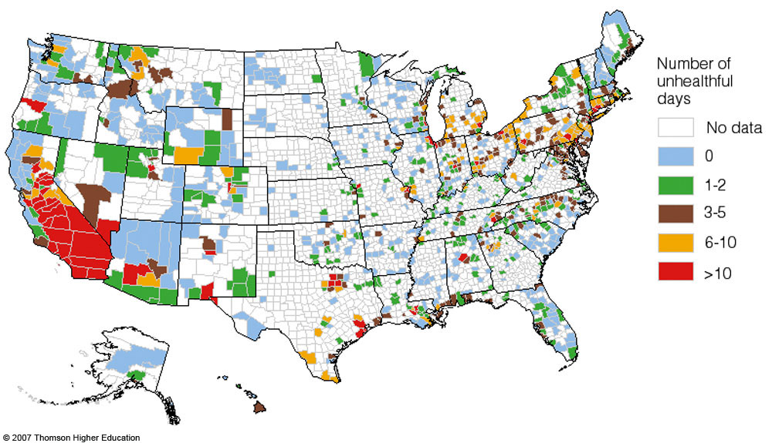
Unhealthful days* CO, SO2, NO2, O3, and PM
*Days not reaching attainment”

Slide 21
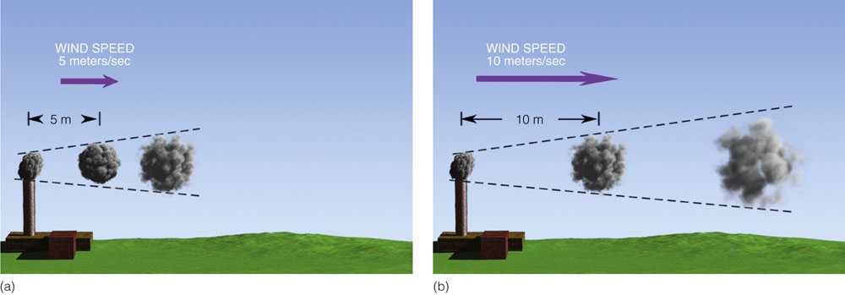
Factors Affecting Pollution
Wind
Dilution
Turbulence
Mixing

Slide 22
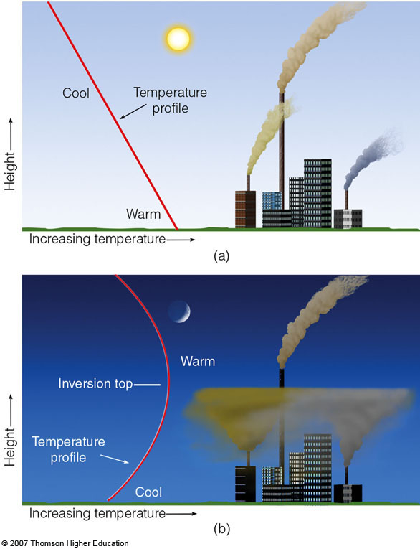
Factors Affecting Pollution
Stability and Inversions
Temperature lapse rates
Inversions
Mixing depth

Slide 23
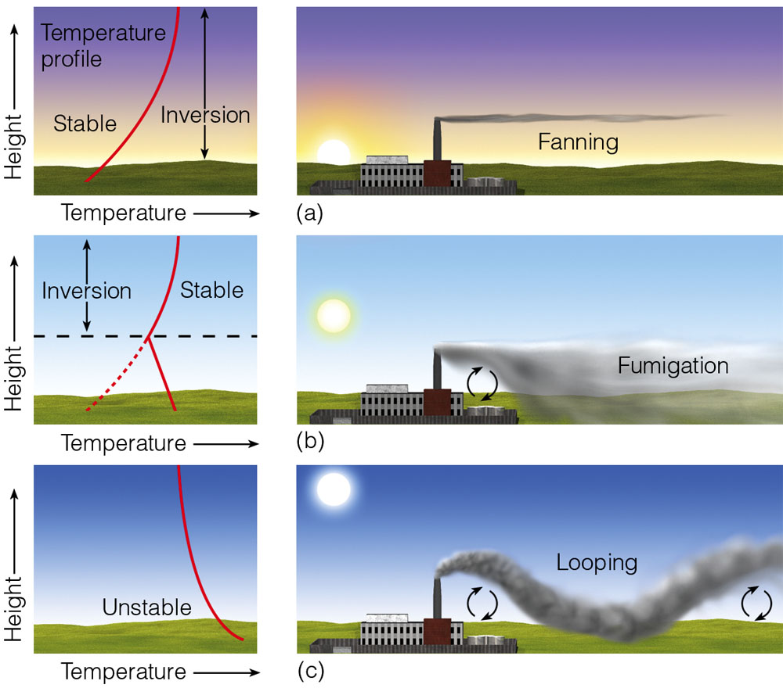
Factors Affecting Air Pollution

Slide 24
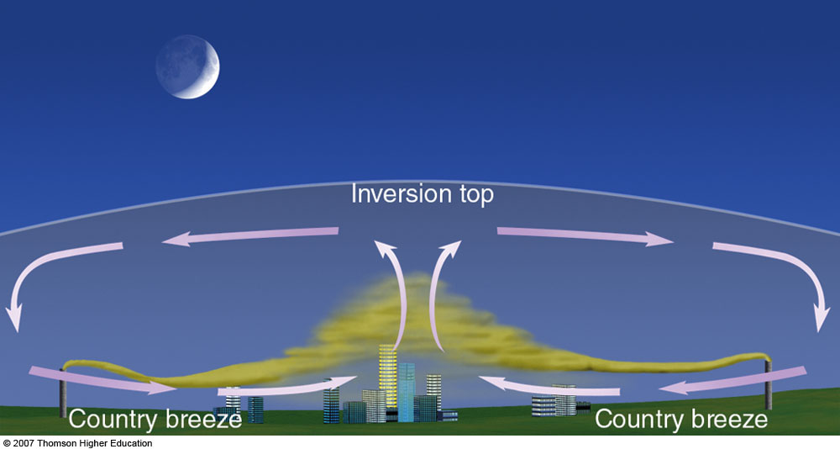
Factors Affecting Air Pollution
Effects of the Urban Environment
Urban heat island
Country breeze

Slide 25
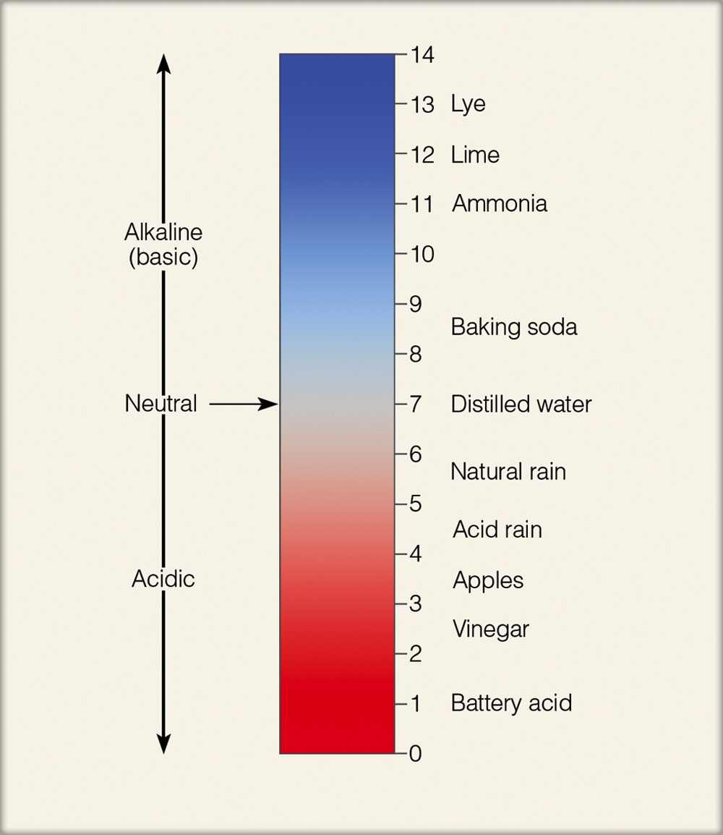
Acidity Scale (pH)

Slide 26
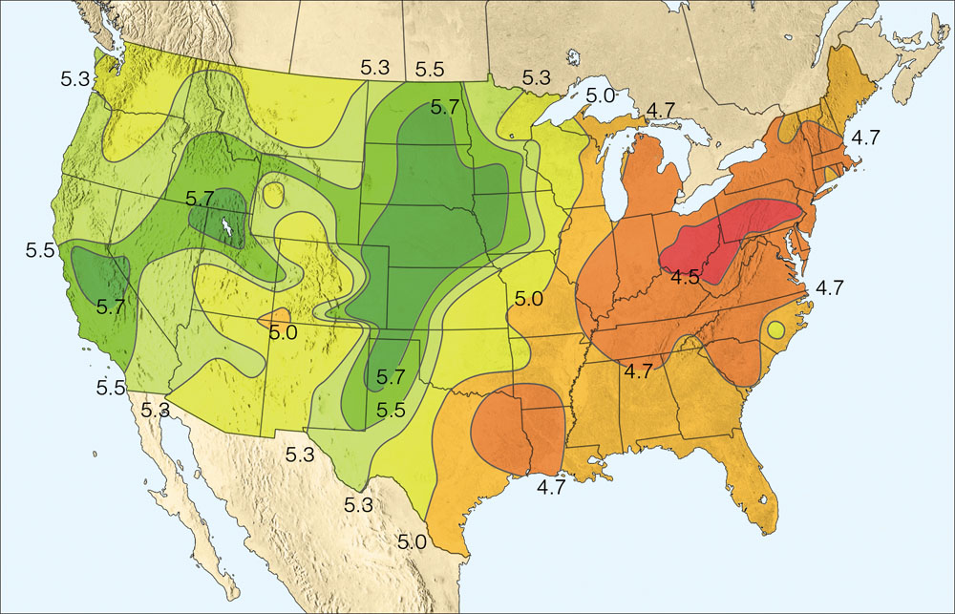
Acid Deposition
Wet deposition
Dry deposition
Acid fog
Acid Rain
Ironically, an acidified lake looks crystal clear and beautiful….but it’s only clear because nothing is alive in it.

Slide 27
Acid Deposition

Slide 29
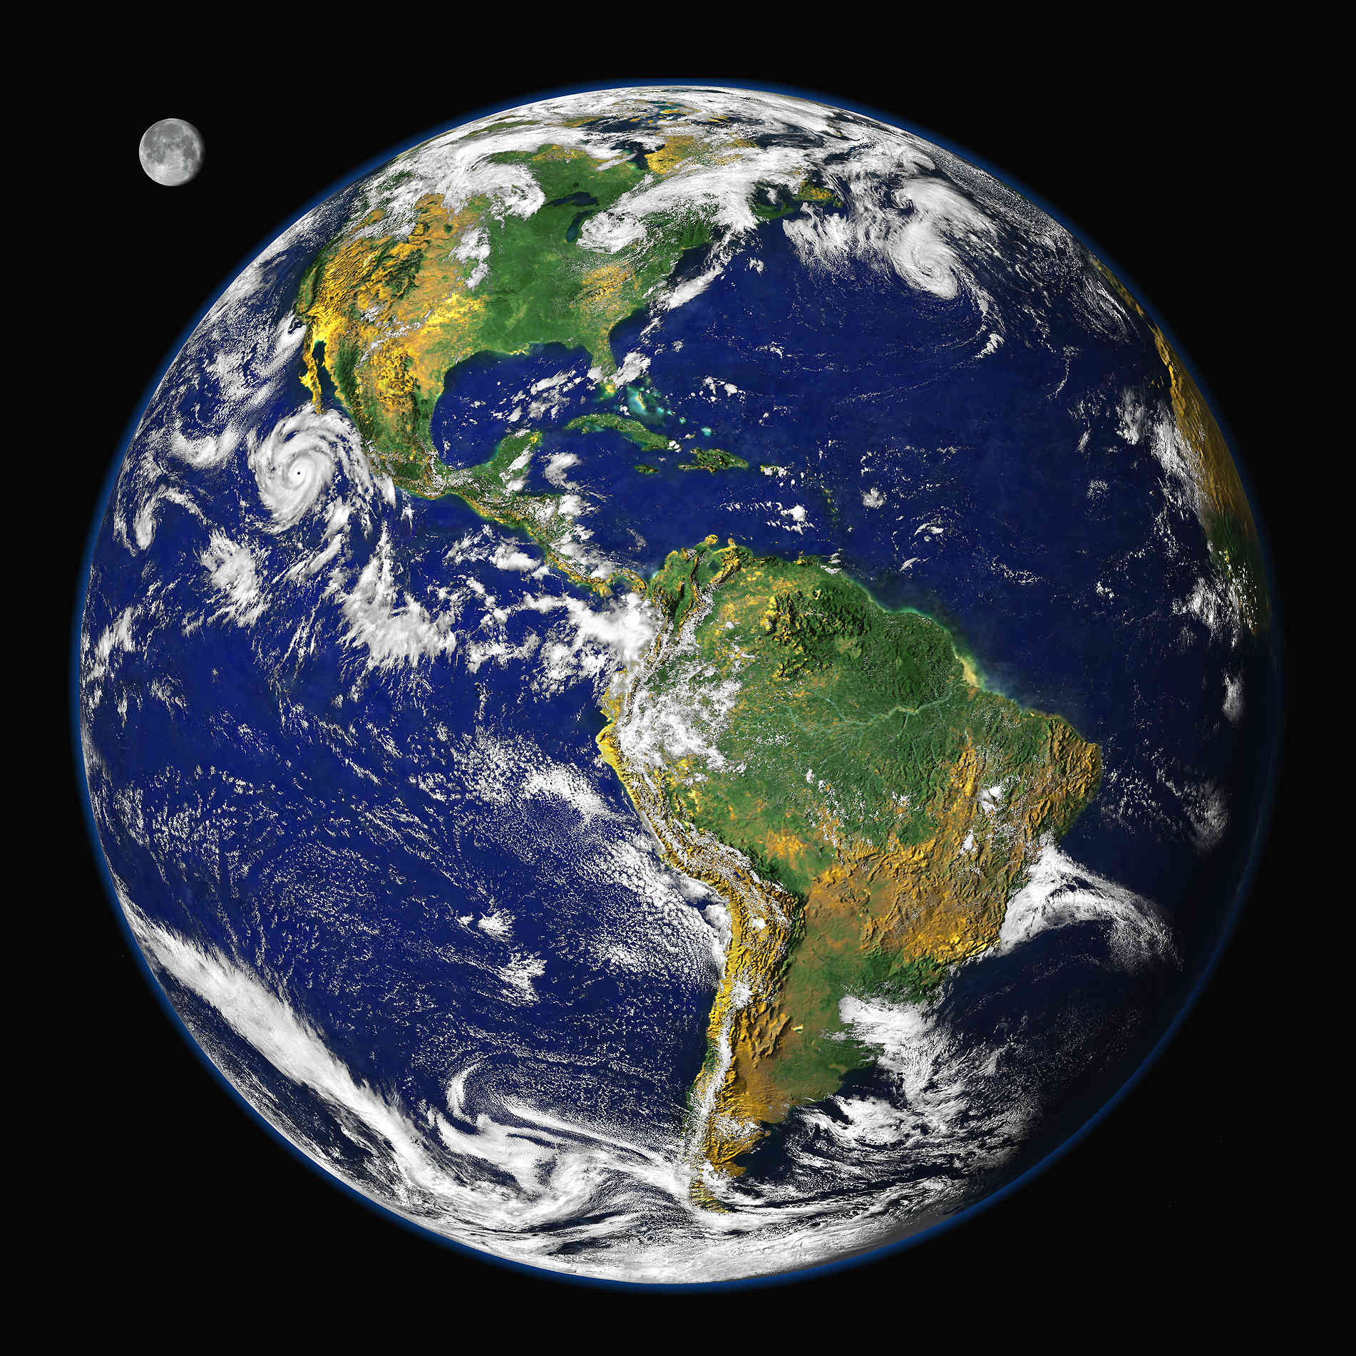
Climate Classifications

Slide 30
CLIMATE CONTROLS
Latitude
Land vs. Water
Geographic Position
Mountains
Ocean Currents
Pressure Patterns and Winds

Slide 31
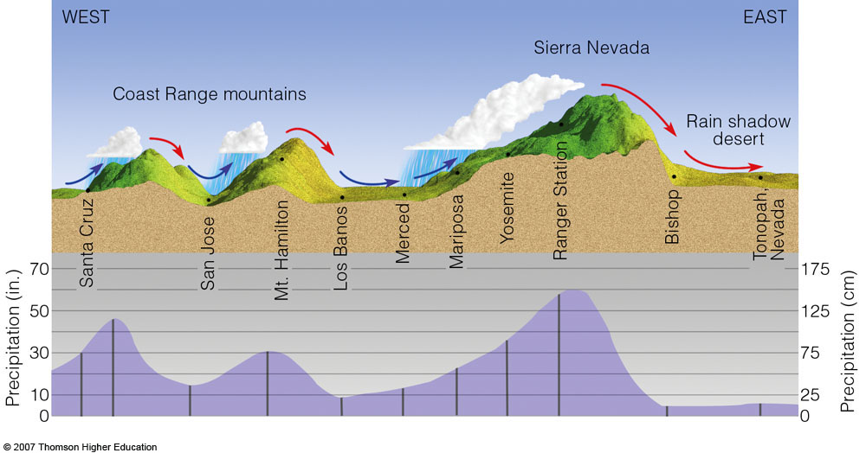
CLIMATE CONTROLS WATER, LAND, MOUNTAINS

Slide 32
CLIMATE CONTROLS – LATITUDE, PRESSURE

Slide 33
Köeppen Climate
German 19th century Biologist
Distribution & Type of Vegetation
5 Major Groups
A - Tropical:
coolest month > 64.4 F
B - Potential ET > Precip
C - Mesothermal:
one month > 50 F
coldest month > 32 F

Slide 34
Köeppen Climate
D - Microthermal:
one month > 50 F
coldest month < 32 F
E - Polar
warmest month < 32 F
HIGHLAND
Climates of great variability due to altitude

Slide 35
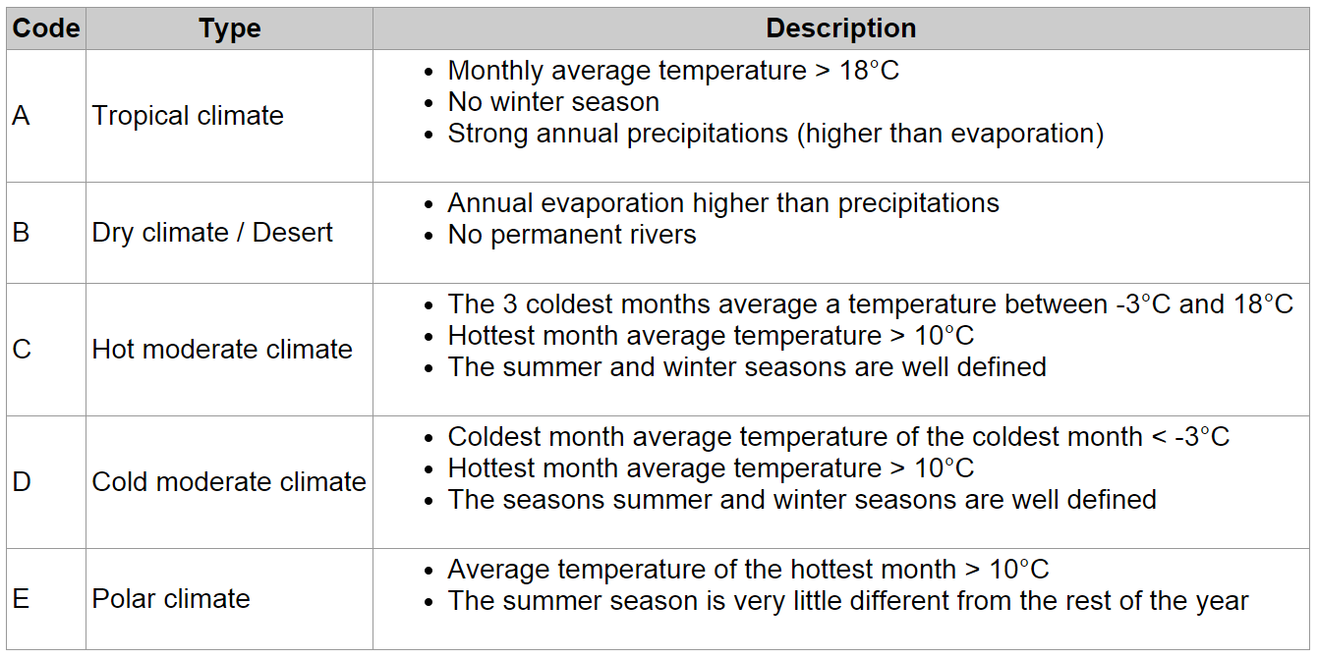
Köeppen Climate – 1st order

Slide 36
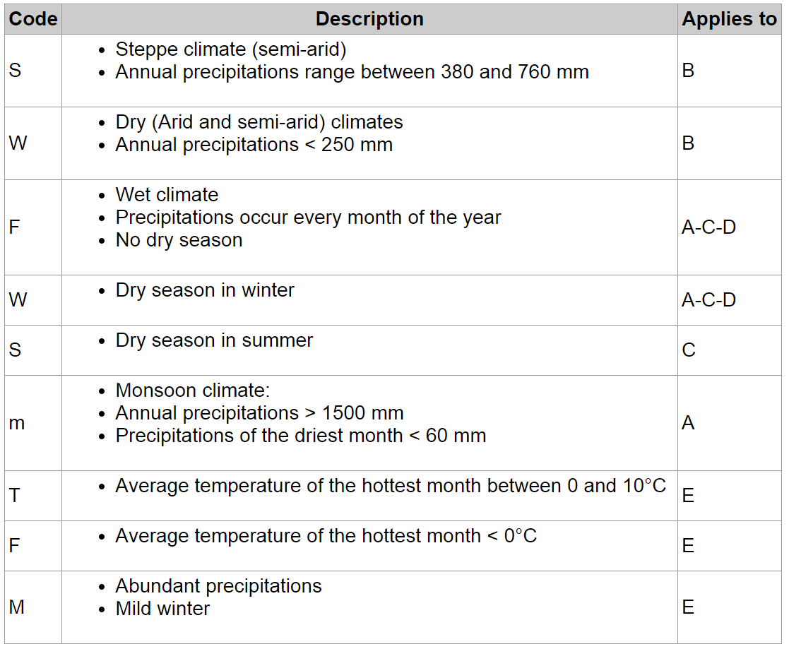
Köeppen Climate – 2nd order

Slide 37
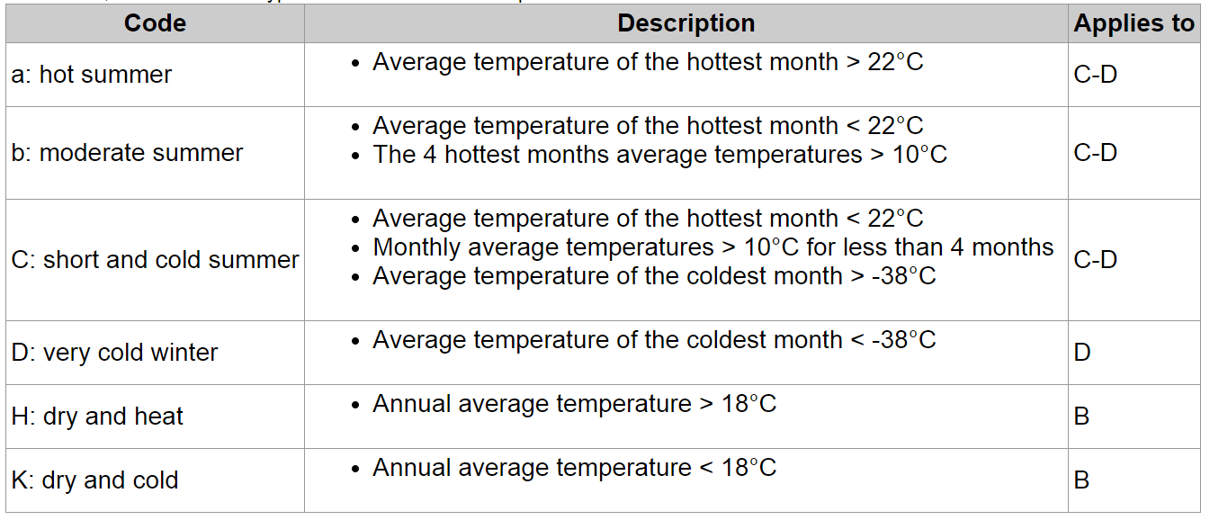
Köeppen Climate – 3rd order

Slide 38
Köeppen Climate
A = Tropical
B = ET > Precip
C = Mesothermal
D = Microthermal
E = Polar

Slide 39
Köeppen Type C
C - Mesothermal: one month > 50° F, coldest > 32 ° F

Slide 40
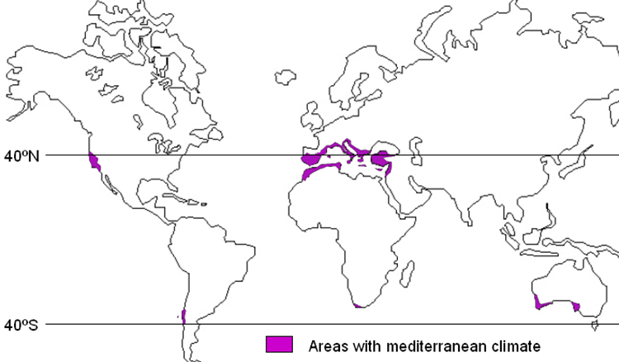
Mediterranean Climate
Csb
C=hot moderate, s=dry summer, b=moderate summer heat
W coasts btwn 30° & 40° latitude
Long dry summers
Mild wet winters
2% earth’s surface
20% of plant species

Slide 41
PERFECT CLIMATE?
It's true! It's true! The crown has made it clear: The climate must be perfect all the year.
A law was made a distant moon ago here, June, July and August cannot be too hot; And there's a legal limit to the snow here... In Camelot.
The winter is forbidden till December... And exits March the second on the dot. By order summer lingers through September... In Camelot.
The rain may never fall till after sundown, By eight the morning fog must disappear.
In short, there's simply not, A more congenial spot for happy everaftering than here …In Camelot.

Slide 42
Perfect Climate?
What is the “best” climate?
Worst?
United States?
Other parts of the world?

Slide 43
CAMELOT CLIMATE INDEX
Weighted Index
Human Comfort
100 = “perfect” climate
Factors
Temp Humidity Index (10%)
No. Days > 90 (15%)
Avg. Min Temp (5%)
No. Days <32 (20%)
Avg. Annual Rainfall (15%)
No. Days of Rain (5%)
Avg. Annual Snowfall (5%)
% of Possible Sunshine (25%)

Slide 44
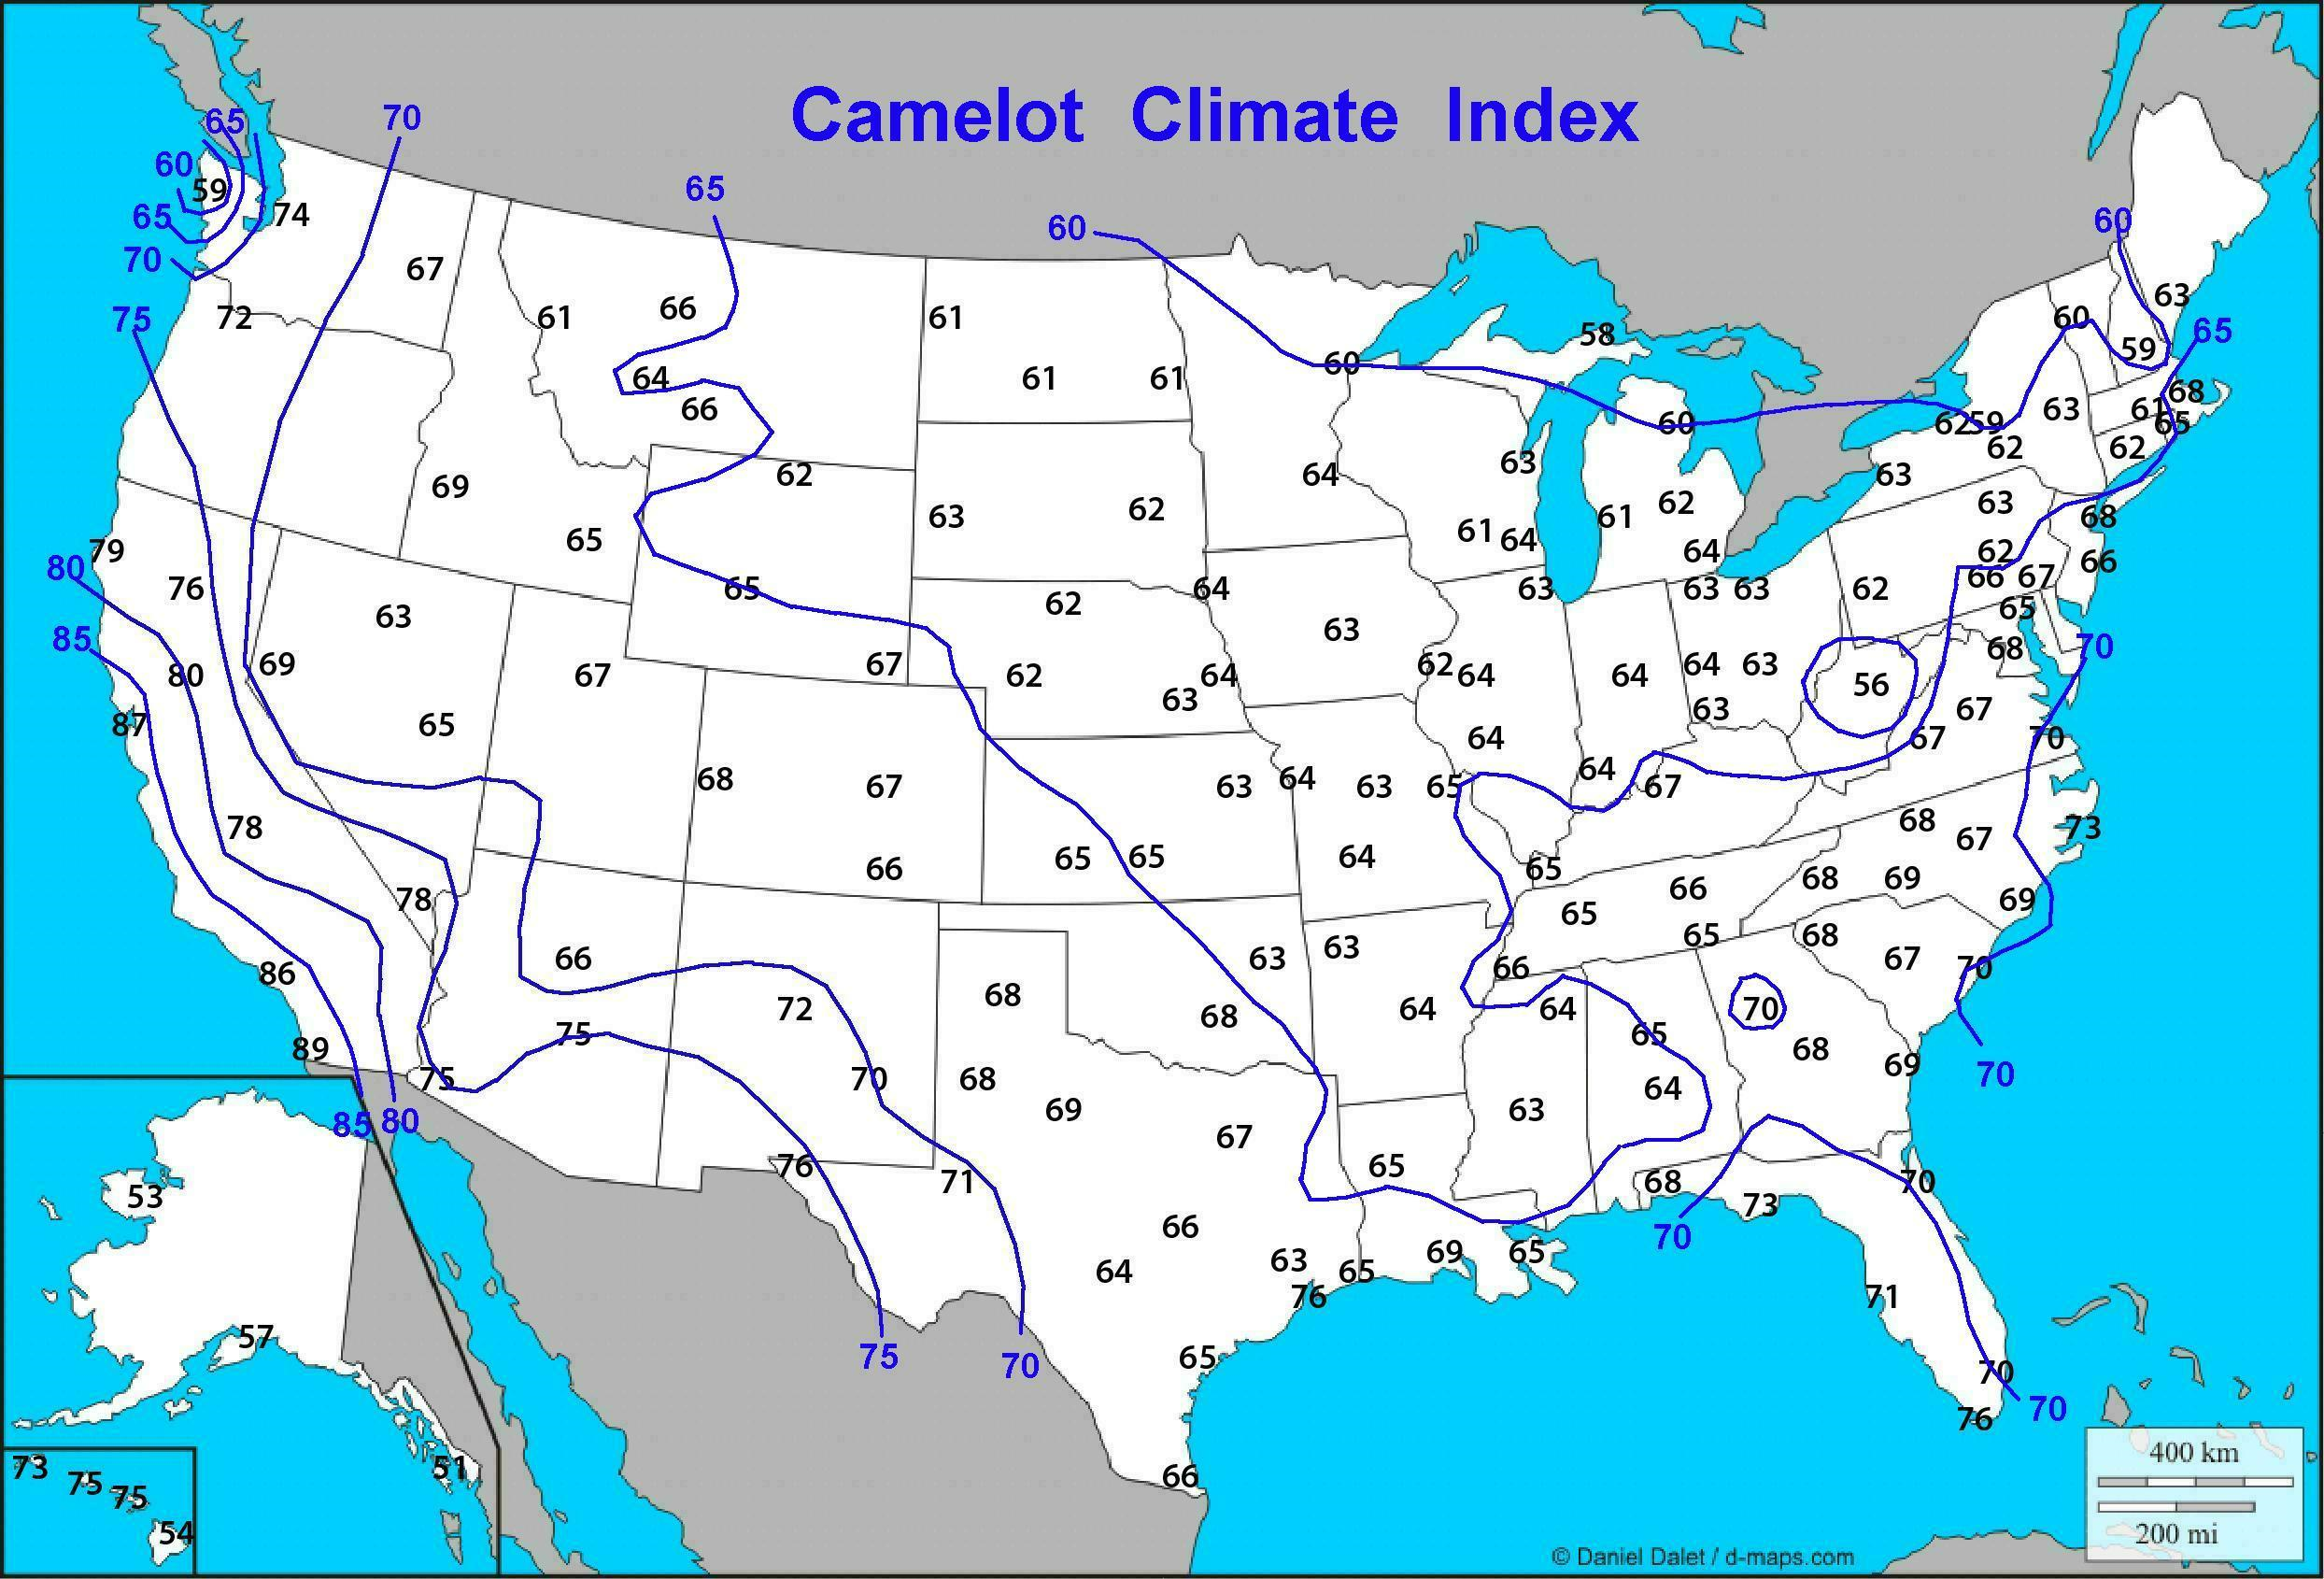
CAMELOT CLIMATE INDEX

Slide 46
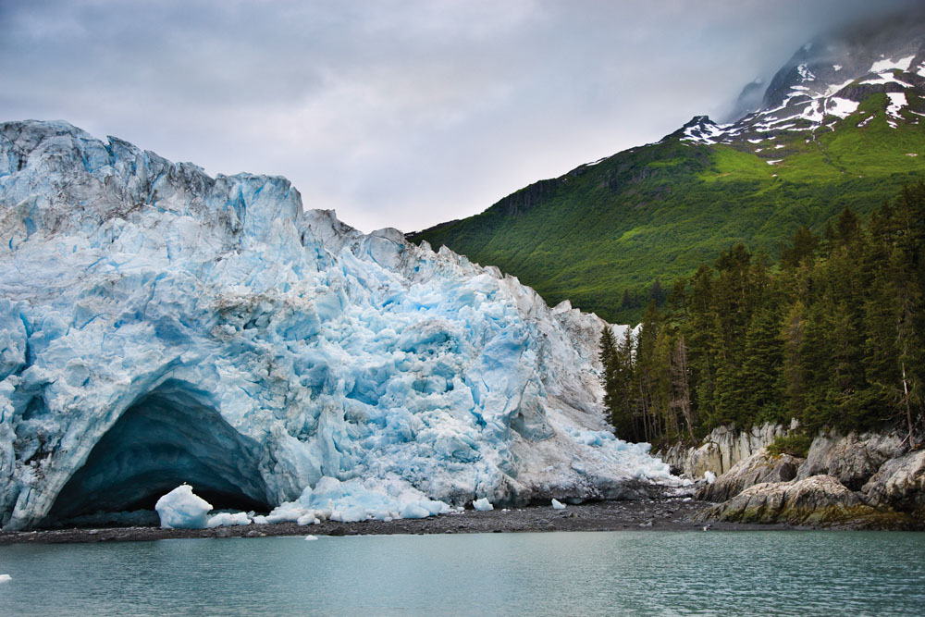
THE EARTH’S CHANGING CLIMATE Chapter 13

Slide 47
Climate Change vs. Global Warming
Climate Change:
Changes in climate of the past, present or future associated with natural or anthropogenic (human) factors
Global Warming:
Warming of the 20th and 21st century associated with anthropogenic activities.

Slide 48
Climate Change
Climate change is complicated
Change impacts some areas more than others
Human perspective is relative
- short lifetimes
GCMs (Global Climate Models) produce multiple outcomes

Slide 49
Looking into the Past
Use caution –
Alternative explanations other than climate change!
For example:
In 17th & 18th centuries, the river Thames in London usually froze in winter
Were winters much colder?
Or:
Did Old London bridge slow river flow down?
Lack of embankments make river wider?
Lack of waste heat from industrial plants?

Slide 50
Reconstructing Past Climates
Instruments records
Proxy measurements
Tree rings
Ice cores
Plate tectonics (folding, faulting) and erosion complicates the picture
Record confused or destroyed (90-99% eroded)
Little remains from first 90% of Earth’s lifetime
Changes in arrangement of continents and oceans

Slide 51
Ice Age
Times in Earth’s history when ice covered a large part of the Earth’s surface
First proposed by Swiss naturalist Louis Agassiz
“Erratics” – rocks found in unusual areas
Found blocks of granite transported 100 kilometers from Alps

Slide 52
From 2.7 to 1.8 Billion Years Ago
“Snowball Earth”: Widespread, global glaciation
Evidence of glaciers in parts of Africa located near the Equator at the time
3 discrete glaciations found in Wyoming between 2.5 and 2.2 billion years ago

Slide 53
Sudden Shift in Climate
Catastrophic event caused increase in CO₂
Earth remained free of ice caps for 1 billion years
Snowball Earth appeared again – several ice ages observed following warm-up
“Cambrian explosion” – after last ice age in this period, acceleration in evolution observed

Slide 54
The Big Five
Five clearly established events of mass extinction
During last 600 million years, 99.9% of all previous species died
Now: 1 million species, 75% insects

Slide 55
100 Million Years Ago
Warmest climate period supported by proxy data
6º C to 12º C warmer than present day
Configuration of continents played a role
Equatorial seaway
Today
Circumpolar ocean current around Antarctica makes Antarctica colder than the Arctic

Slide 56
End of the Mesozoic
248 to 65 Million Years Ago
Sudden cooling observed
One of the “Big Five”
Dinosaurs extinct

Slide 57
Pleistocene
1.8 million to ~10,000 years ago
Repeated ice ages – 32% of Earth covered by ice
Evidence of 7 glacial periods
Each glacial period occurs every 100,000 years
Each glacial period had substantial fluctuations in climate – from extreme cold to near interglacial warmth.
Fluctuation in climate dominated by cycles of 21,000, 41,000, and 100,000 years.
From sediment/ice core data – changes can be sudden!

Slide 58
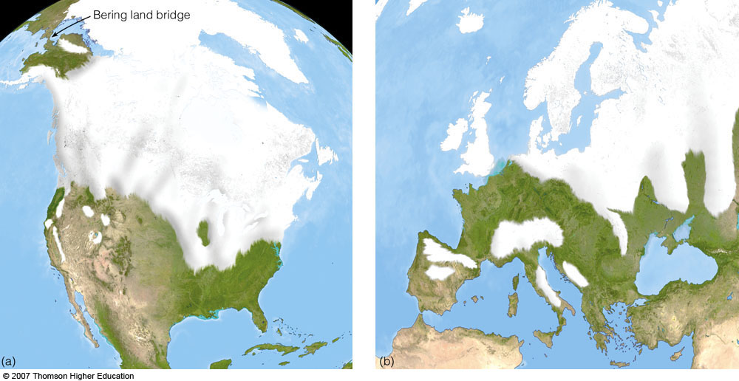
Pleistocene
Approx: 18,000 years ago

Slide 59
End of Pleistocene
Last ice age maxed out about 18,000 years ago
Ice sheet 3 kilometers thick as far south as Great Lakes
Total ice volume of ~ 90,000,000 km3 (30 million today)
Sea level lower by 90-120 meters
Global average temperatures 5º C colder than now
Dramatic warming started 15,000 years ago
Rapid change in circulation pattern seen (dust)
Conclusion: Climate is capable of sudden, large shifts

Slide 60
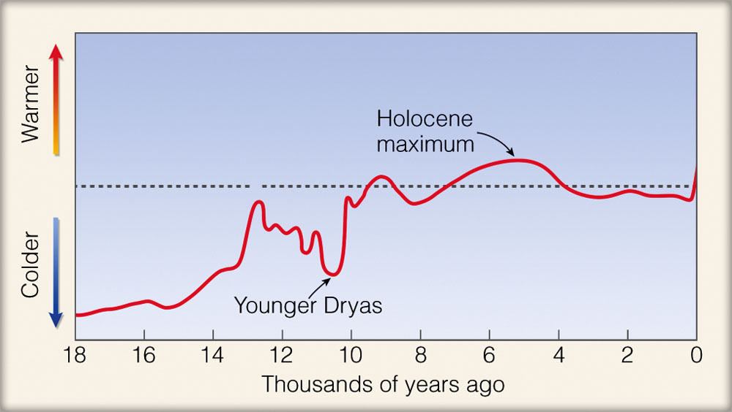
CLIMATE THROUGH THE AGES
Fig. 15.4, p. 433
Notes:
Relative air temperature variations (warmer and cooler periods) during the past 18,000 years. These data, which represent temperature records compiled from a variety of sources, only give an approximation of temperature changes. Some regions of the world experienced a cooling and other regions a warming that either preceded or lagged behind the temperature variations shown in the diagram.

Slide 61
The Holocene
Recent 10,000 years
Warm, stable interglacial period
Extraordinary quiet phase compared to earlier eras

Slide 62
6,000 Years Ago
Laurentide ice sheet disappeared
Peak in post-glacial warming
Temperatures 2-3º C warmer than now

Slide 63
5,000 Years Ago
Cooler and Drier conditions
Historical records can be used now
Mountain glaciers growing

Slide 64
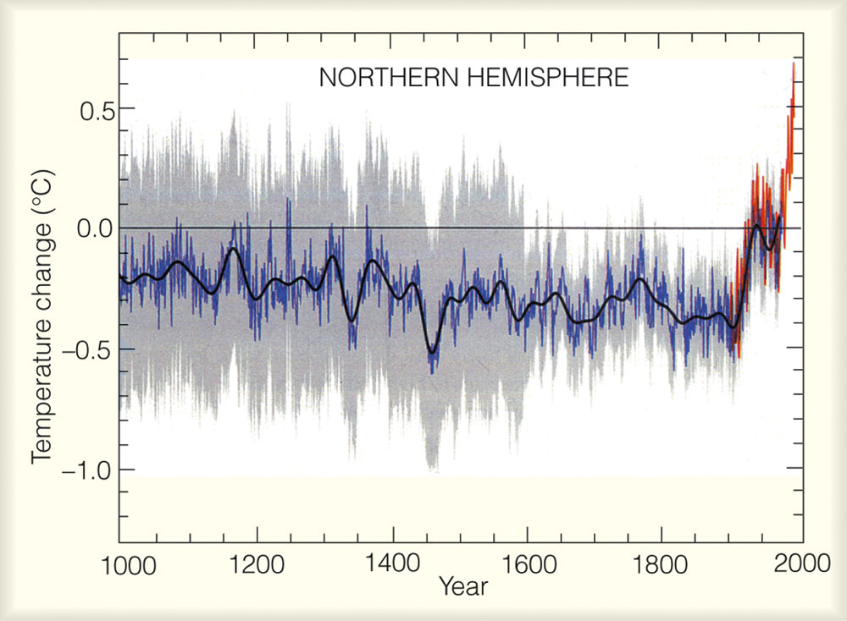
Notes:
The average temperature variations over the Northern Hemisphere for the last 1000 years relative to the 1961 to 1990 average (zero line). Yearly temperature data from tree rings, corals, ice cores, and historical records are shown in blue. Yearly temperature data from thermometers are in red. The black line represents a smoothing of the data. (The gray shading repre­sents a statistical 95 percent conﬁdence range in the annual temperature data, after Mann, et al., 1999.) (Source: From Cli­mate Change 2001: The Scientiﬁc Basis, 2001, by J.T. Houghton, et al. Copyright © 2001 Cambridge University Press. Reprinted with permission of the Intergovernmental Panel on Climate Change.)

Slide 65
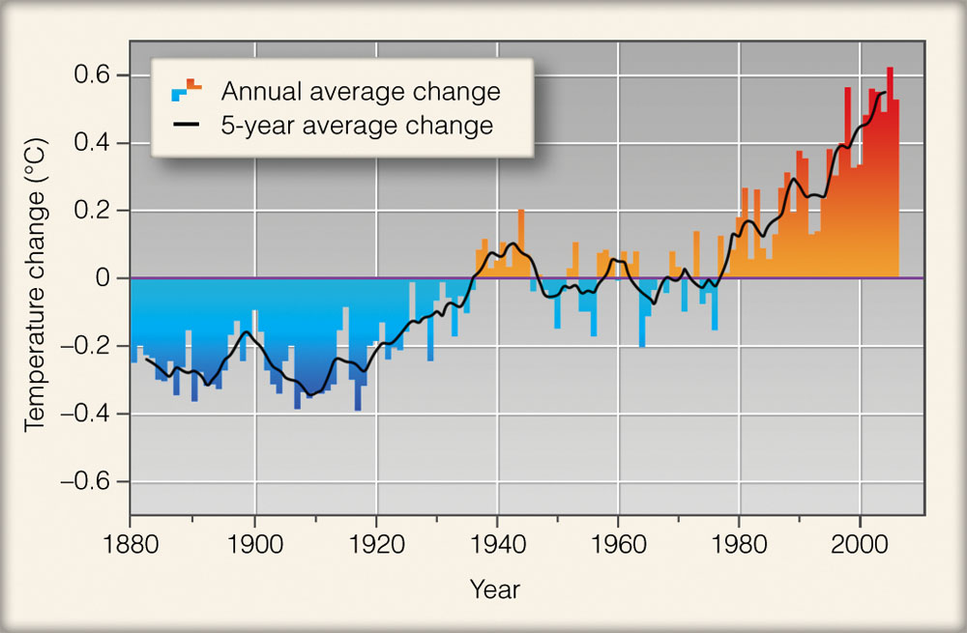
Notes:
The red and blue bars repre­sent the annual average temperature variations over the globe (land and sea) from 1880 through 2006. Temperature changes are compared to the aver­age surface temperature from 1951 to 1980. The dark solid line shows the five-year average temperature change. (NASA)

Slide 66
Since Late-19th Century
Global warming
Evidence comes primarily from instruments
Annual global temperatures have risen ~ 1º F
Warmest years in the record have all fallen in 1990s
Warmest 20-year periods: 1925-1944, 1978-1997
Slight cooling in-between these years

Slide 67
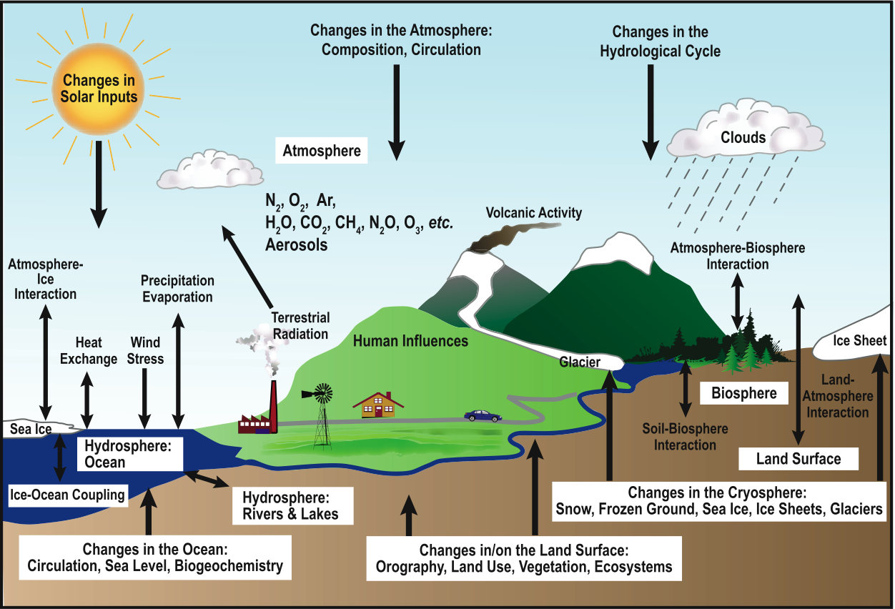
Climate System Components
Notes:
FAQ 1.2, Figure 1. Schematic view of the components of the climate system, their processes and interactions.

Slide 68
CLIMATE CHANGE CAUSED BY NATURAL EVENTS
External Causes
Change in incoming radiation
Change in composition of the atmosphere
Change in Earth’s surface
Feedback Mechanisms
Water vapor-greenhouse gas feedback (+)
Snow-albedo feedback (+)
Infrared radiation (-)

Slide 69
ANTHROPOGENIC CLIMATE CHANGE
Aerosols in the Lower Atmosphere
Sources: factories, autos, trucks, aircraft, power plants, home furnaces and fireplaces
Not injected directly into the atmosphere, but form when gases convert to particles
Highly reflective sulfate aerosols
May be a net cooling effect

Slide 70
ANTHROPOGENIC CLIMATE CHANGE
Increasing Levels of Greenhouse Gases
Carbon dioxide
Burning fossil fuels
Deforestation
Methane, nitrous oxides, CFCs

Slide 71
The Greenhouse Effect
Greenhouse gases:
Transparent to incoming solar radiation
Efficiently absorb outgoing long-wave radiation
Lead to a warmer atmosphere

Slide 72
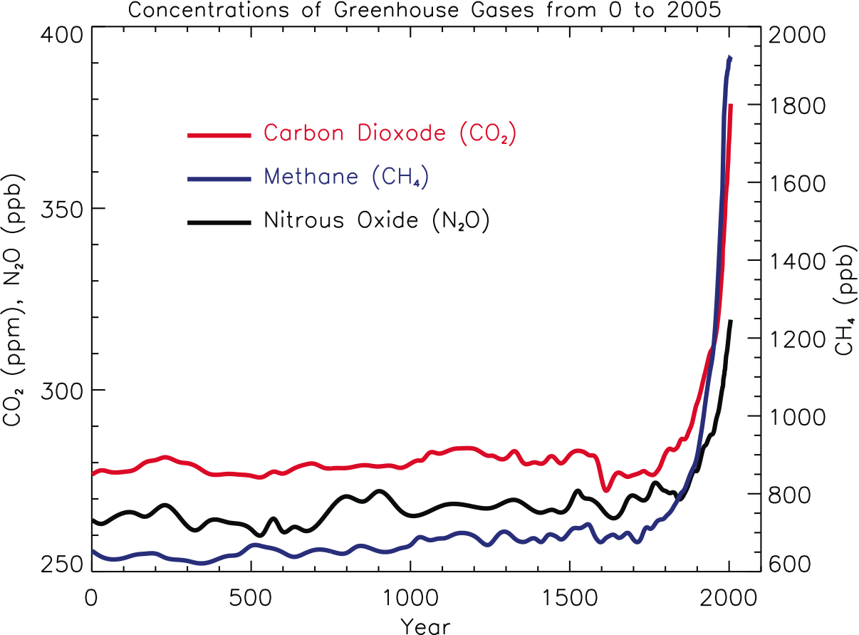
Greenhouse Gases
Current CO₂: ~380 ppm

Slide 73
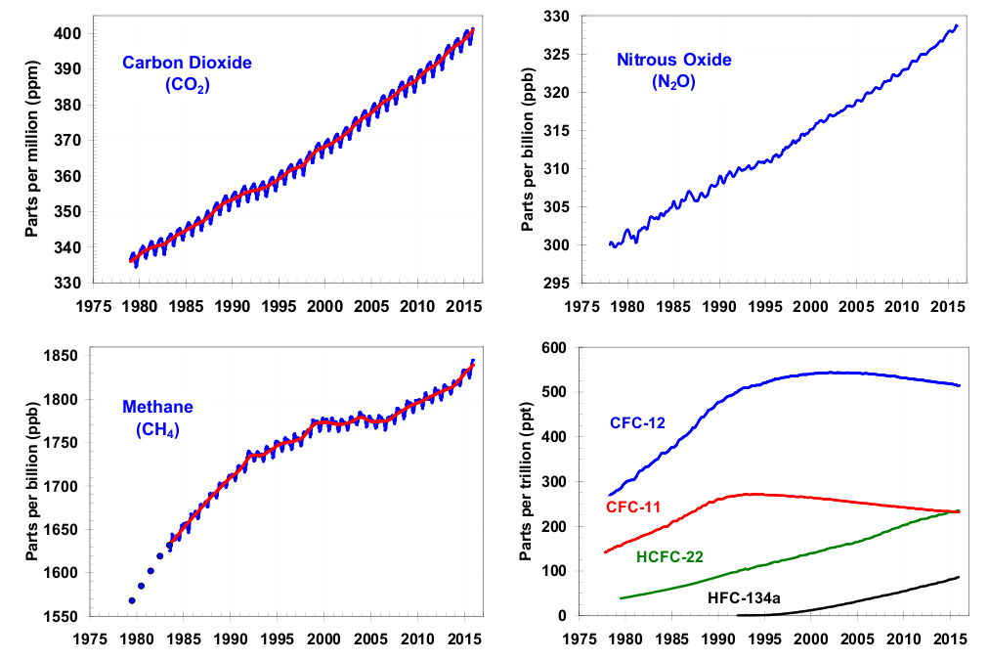
Greenhouse Gases

Slide 74
Greenhouse Gases
Contributions to atmospheric warming
Water Vapor ~60%
Carbon Dioxide ~26%
Ozone ~8%
Others ~6%

Slide 75
Recent Warming
Decrease in exceptionally cold temperatures
Increase in exceptionally warm temperatures
Minima have increased more rapidly than maxima
Most pronounced warming – northern continents
Marked cooling
NW Atlantic Ocean
Less in north central Pacific
Changes appear most clearly in winter

Slide 76
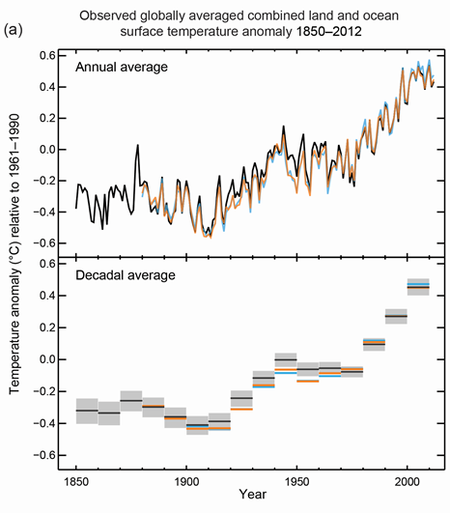
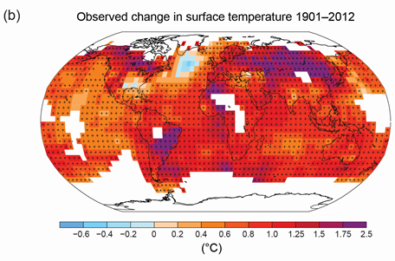
Recent Warming

Slide 77
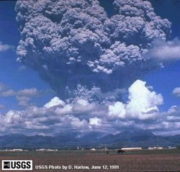
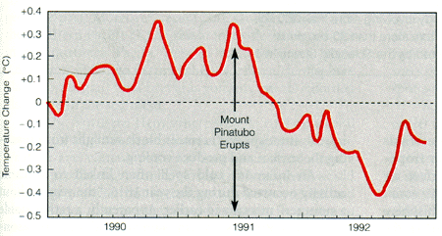
Mt. Pinatubo - Global Cooling
1991 - Changing forcing changes the temperature (and water vapor, etc.)

Slide 78
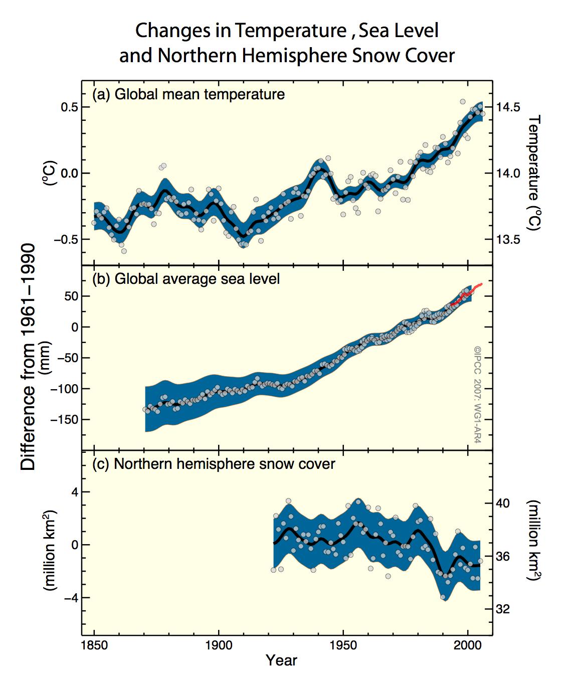
Warming Measurements

Slide 79
IPCC
Intergovernmental Panel on Climate Change
Established 1988 by WMO
194 nations
3000+ climate scientists
2014 Issued 5th Assessment Report Summary

Slide 80
IPCC Assessment Summary
Warming of the climate system is unequivocal
Most of global temperature is very likely (>90%) anthropogenic (human)
Anthropogenic warming and sea level rise would continue for centuries
Probability warming is only natural variation is less than 5%
World temperatures could rise between 2 and 11 °F
Sea levels will probably rise by 7 to 23 in

Slide 81
Future projections of CO₂ Concentrations
What happens in the future depends on how much more CO₂ we release into the atmosphere
Even the low-emission scenarios result in greatly increased CO₂ concentrations by the year 2100
Current Concentration: ~400 ppm
Max scenario: 970 ppm
Min scenario: 550 ppm

Slide 82
Climate Change Summary
Higher temperatures –
Especially on land
Polar Regions
Hydrological cycle more intense
Storms have more “fuel,” so they can be more powerful, thus more intense rain
Sea levels rise
Oceans expand with extra heat
Melting of polar ice

Slide 83
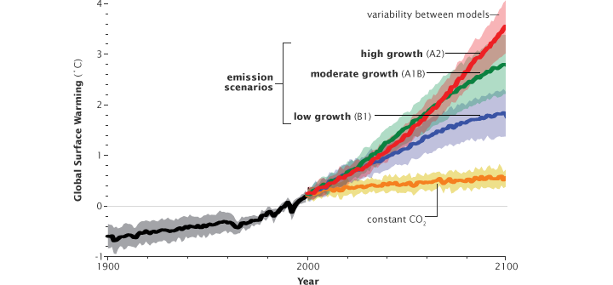
Future Temperature Projections

Slide 84
Temperature Projections
Projected Warming (2000 – 2100)
From ~2.5°F to ~10.5°F
Not all places will warm at the same rate
Curves represent seven independent scenarios
Each bar on right represent range of warming produced by models of differing sensitivities for a specific scenario.

Slide 85
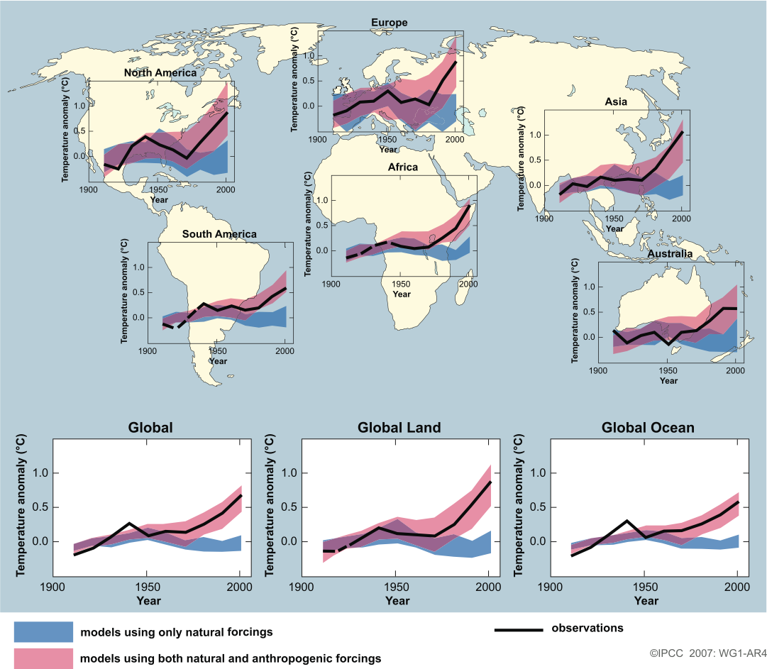
GCM Forecasts

Slide 86
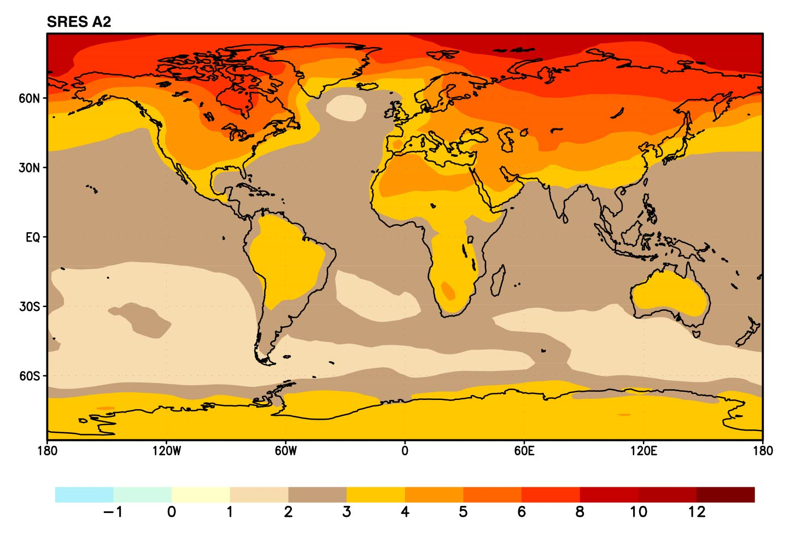
“Median” Scenario Temperature Projections
Land areas projected to warm more than oceans
Greater warming at high latitudes
Annual mean temperature change: 2071 to 2100 Relative to 1990

Slide 87
Other Possible Impacts
As Poles warm more quickly than tropics…
The jet stream will weaken and move north
The storm track will also move north
Latitude bands 30-40 degrees should get drier
Rain events begin to replace snow events
Reduction in the # of strong tornadoes in U.S.
Tornado Alley migrates north
Atlantic hurricanes will more easily form and be generally stronger

Slide 88
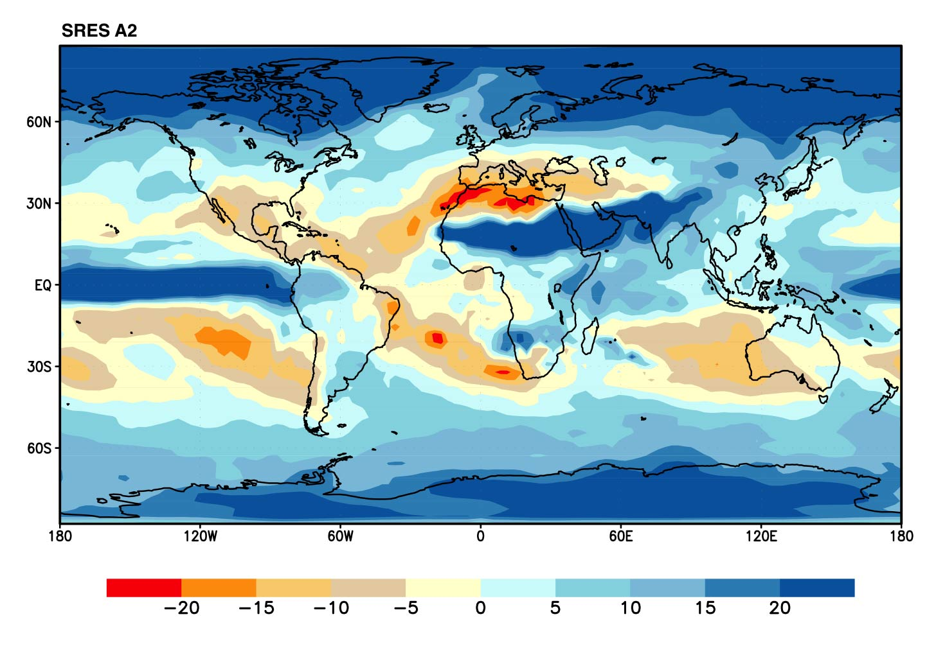
Some areas are projected to become wetter, others drier with an overall increase projected
“Median” Scenario Precipitation Projections
Annual mean precipitation change: 2071 to 2100 Relative to 1990

Slide 89
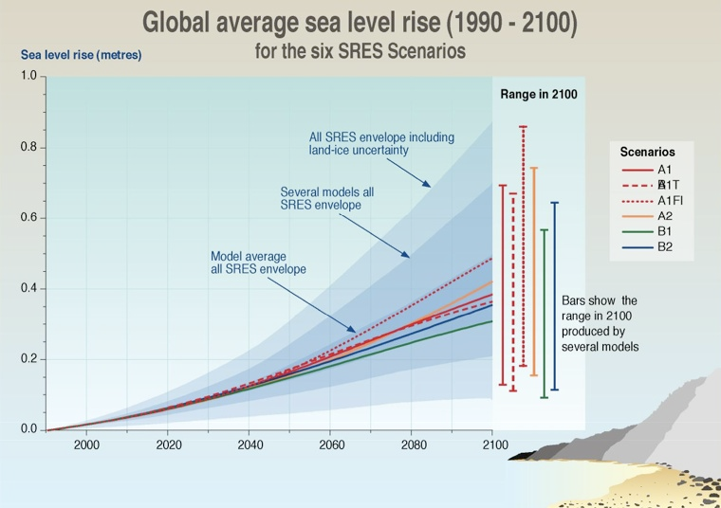
Sea Level Projections

Slide 90
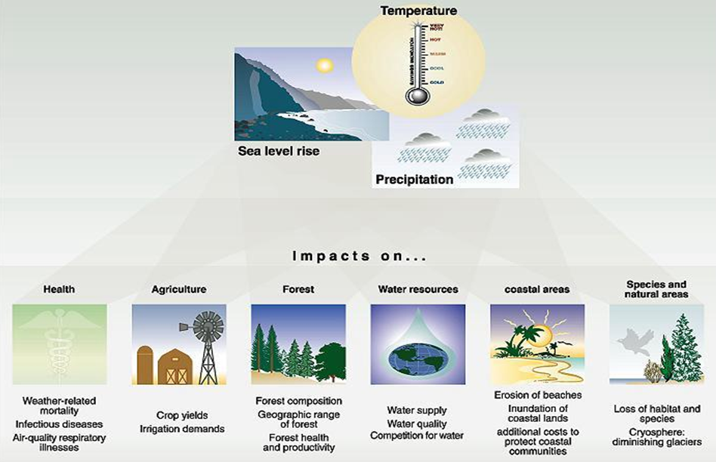
Potential Climate Change Impacts
Notes:
Finally in relation to CO2 or greenhouse warming there is the vexatious question of the role of cloud.
GO THROUGH
To some extent the role of cloud depends on its height in the atmosphere. Low level cloud tends toward warming through long wave trapping, while high level cloud leads to cooling through solar radiation reflection
In our final slide today, lets briefly look at surface characteristics.
GO THROUGH

Slide 91
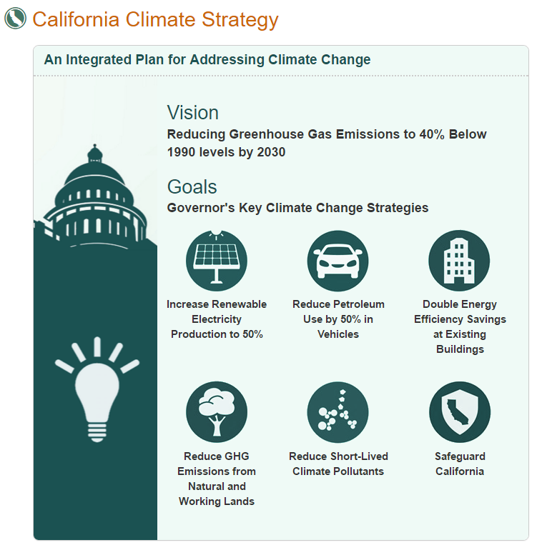

Slide 92
Predictions For the Bay Area
Decreased winter precipitation as jet stream moves north
Increased summer precipitation as water is warmer/more subtropical moisture
Weaker sea breezes due to warmer ocean temperatures results in hotter summers
Less snowpack in Sierra Nevada, leading to water shortages

Slide 93
Other Impacts

Slide 94
Feedback Mechanisms
Climate is linked with many physical processes
A change in part of the climate system may cause subsequent changes in other parts
Subsequent changes could support or act against the original change

Slide 95
Positive Feedback
When the response in a second variable reinforces the change in the initial variable
Example of positive feedback:
Global temperatures increase
Increase in temperature melts the ice and snow in the upper latitudes
Loss of ice and snow results in a lower albedo at the surface in the upper latitudes
Lower albedo leads to less reflection and more insolation
More insolation results in warmer temperatures

Slide 96
Negative Feedback
When the response in a second variable lessens the change caused by the initial variable
Example of negative feedback:
Global warming leads to more atmospheric water vapor
Increased water vapor leads to increased cloud cover
Increased cloud cover leads to a higher albedo
Higher albedo results in less insolation at the surface
Reduced insolation at the surface leads to cooling

Slide 97
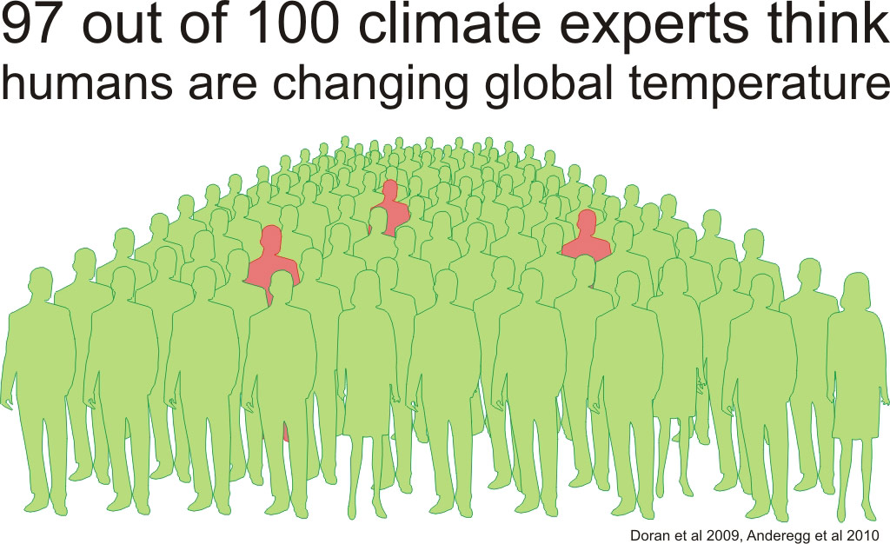
Counter Argument

Slide 98
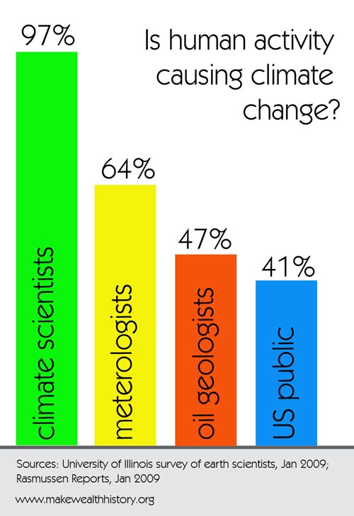

Slide 99
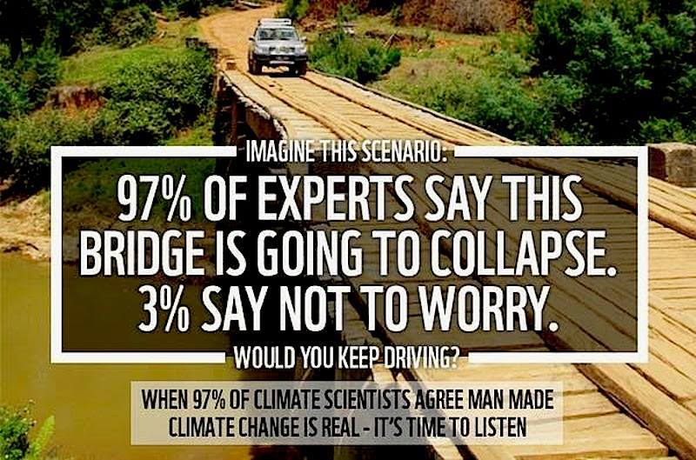

Slide 100
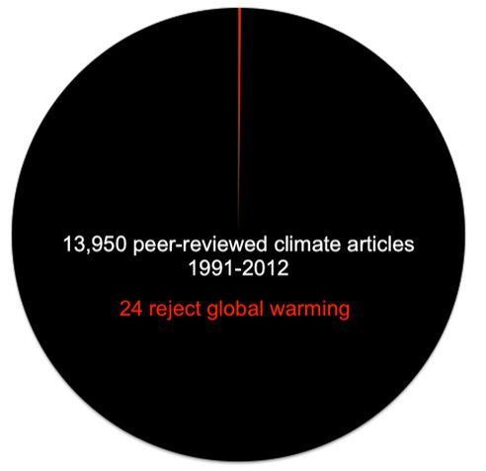
Deniers

Slide 101
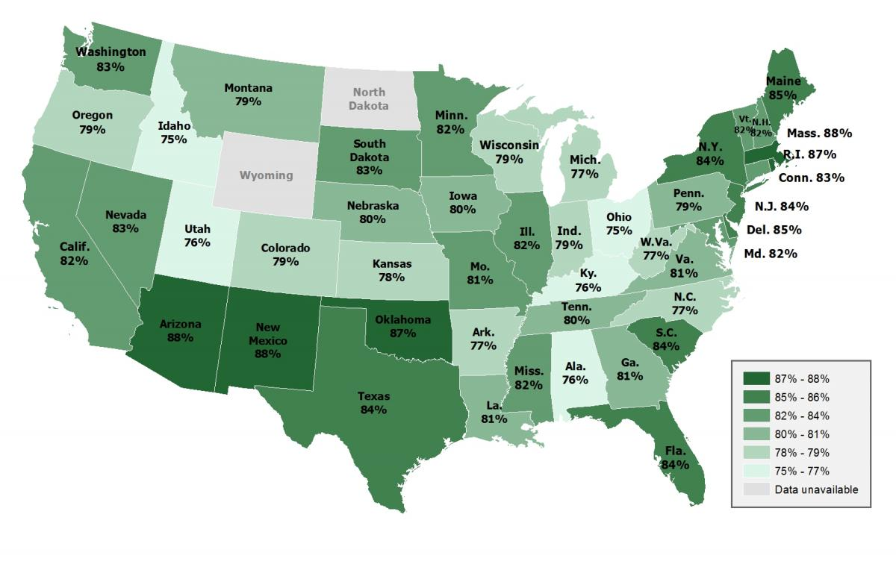
Is Global Warming Happening

Slide 102
Warming Caused by Humans

Slide 103
Warming a Serious Problem?

Slide 104
Counter Argument

Slide 105
Counter Argument to Change in Solar Output

Slide 106
Counter Argument to Short CO₂ Record

Slide 107
Counter Argument to Flawed Dataset

Slide 108
Paris Climate Agreement

Slide 109
Paris Climate Agreement

Slide 110
More Information
New Scientist
Climate Change: A Guide for the Perplexed
http://www.newscientist.com/article/dn11462-climate-change-a-guide-for-the-perplexed.html
American Meteorological Society
http://www.ametsoc.org/policy/2007climatechange.pdf
IPCC
http://www.ipcc.ch/

Slide 112
HW #13 – “Skeptical Science” 40 pts
http://www.skepticalscience.com/argument.php

Slide 113
HW #13 – “Skeptical Science” 40 pts
http://www.skepticalscience.com/argument.php
Choose one of top 11 myths
Write at least one paragraph summarizing the arguments and counter-arguments.
Write a second paragraph explaining why you agree or disagree, including any source you might have found to support your view.
Due beginning of class Monday May 16
Typed.
No emails
No late assignments.

